Slide 1
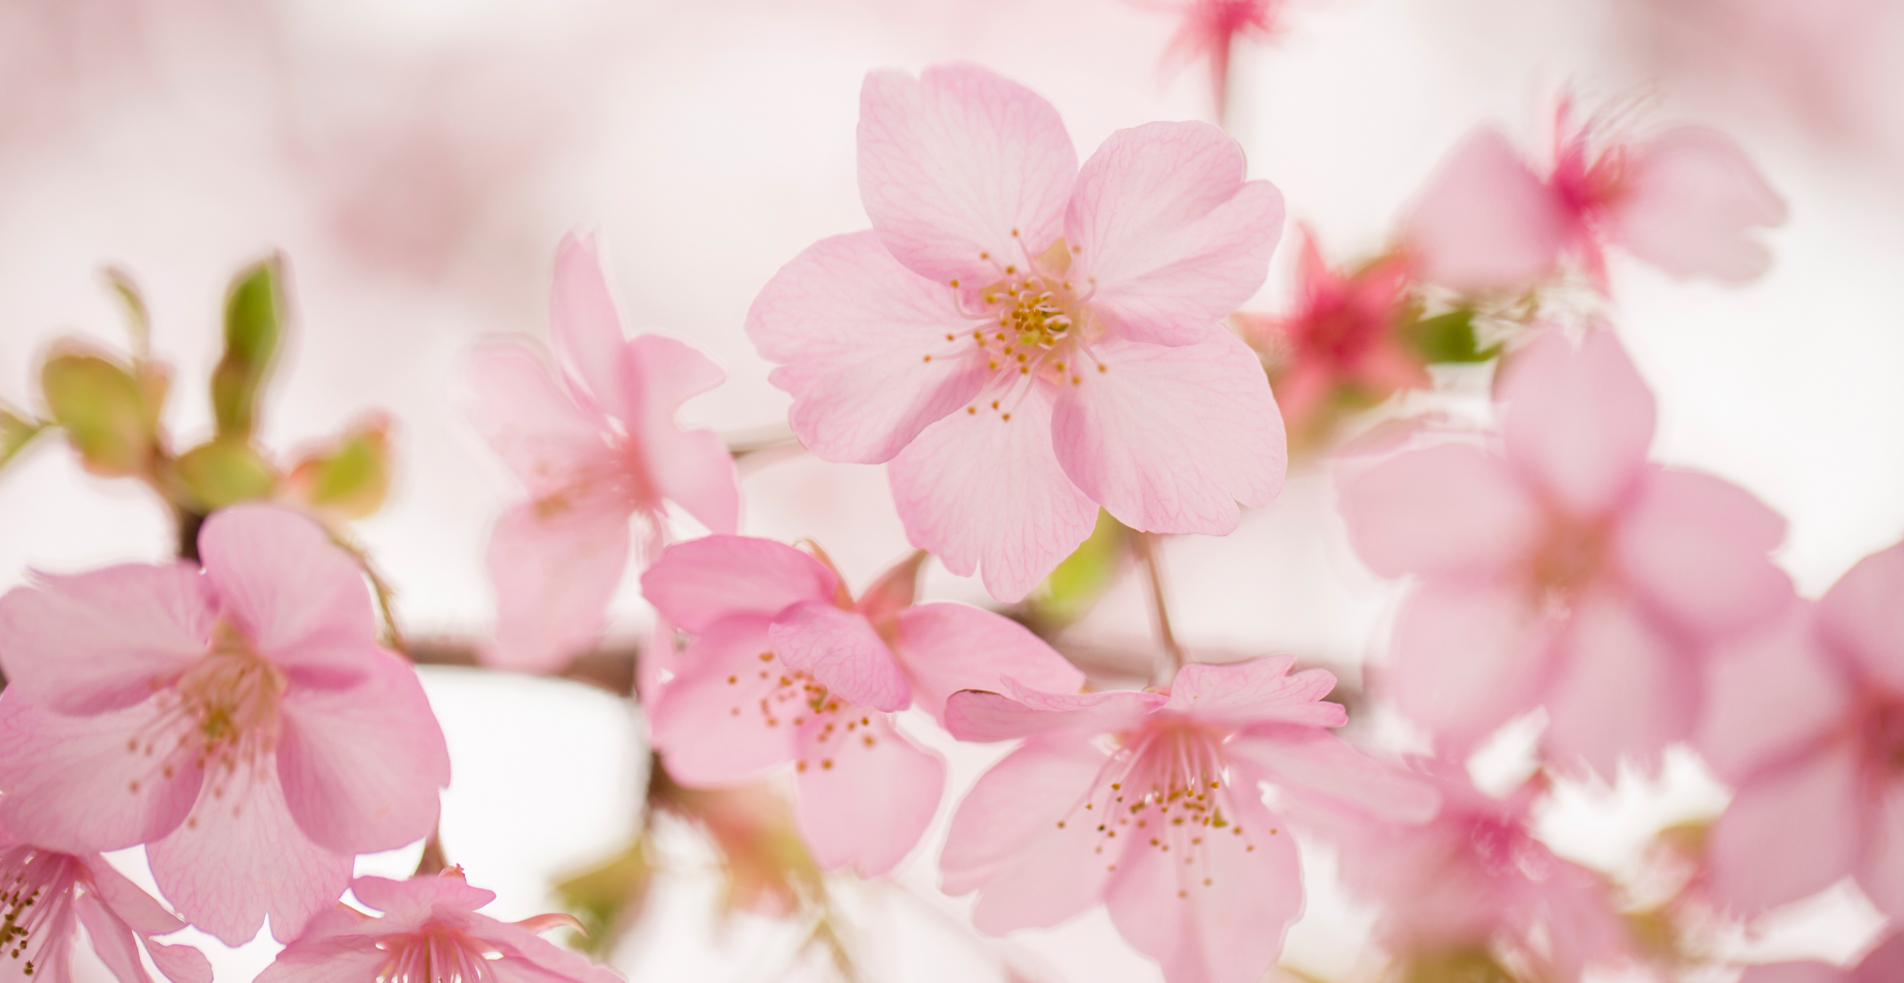
About me by Starry Li (4D)
My name is Starry Li. I am nine years old. I live in Kwun Tong. I like black. I am short and thin. I have one sister. She is taller than me.
I like collecting stamps and reading comics in my spare time because they were fun and interesting. I sometimes play computer games on Sundays.

